Slide 1
Graph ADT

Slide 2
Points to Discuss
Basic Definitions and Graph Representation issues
Graph Traversal
Breadth-First Search(BFS)
Depth-First Search(DFS)
Topological Sorting
Strongly Connected Components
Transitive Closure
Single Source shortest paths: Dijkstra’s Algo
All-pairs shortest paths: Floyd-Warshall’s Algo
Minimum Spanning Tree:Prim’s &Kruskal’s Algo
UCT203 Data Structures and Algorithms

Slide 3
Graphs
Graph G = (V, E)
  V = set of vertices
  E = set of edges ⊆ (V×V)
Types of graphs
  Undirected: edge (u, v) = (v, u); for all v, (v, v) ∉ E (No self loops.)
  Directed: (u, v) is edge from u to v, denoted as u → v. Self loops are allowed.
  Weighted: each edge has an associated weight, given by a weight function w : E → R.
  Dense: |E| ≈ |V|².
  Sparse: |E| << |V|².
|E| = O(|V|²)
UCT203 Data Structures and Algorithms

Slide 4
Graphs
If (u, v) ∈ E, then vertex v is adjacent to vertex u.
Adjacency relationship is:
  Symmetric if G is undirected.
  Not necessarily so if G is directed.
If G is connected:
  There is a path between every pair of vertices.
  |E| ≥ |V| – 1.
  Furthermore, if |E| = |V| – 1, then G is a tree.
.
UCT203 Data Structures and Algorithms

Slide 5
Representation of Graphs
Two standard ways.
  Adjacency Lists.
  Adjacency Matrix.
a
b
a
b
d
c
b
a
c
c
d
c
d
a
b
d
a
c
1
2
1 2 3 4
1 0 1 1 1
2 1 0 1 0
3 1 1 0 1
4 1 0 1 0
a
b
c
d
3
4
UCT203 Data Structures and Algorithms

Slide 6
Adjacency Lists
Consists of an array Adj of |V| lists.
One list per vertex.
For u ∈ V, Adj[u] consists of all vertices adjacent to u.
a
b
a
b
d
c
b
c
If weighted, store weights also in adjacency lists.
c
d
c
d
d
a
b
a
b
d
c
b
a
c
c
d
c
d
a
b
d
a
c
UCT203 Data Structures and Algorithms

Slide 7
Storage Requirement
For directed graphs:
  Sum of lengths of all adj. lists is
∑out-degree(v) = |E|
^{v∈V}
  Total storage: Θ(V+E)
For undirected graphs:
  Sum of lengths of all adj. lists is
∑degree(v) = 2|E|
^{v∈V}
  Total storage: Θ(V+E)
No. of edges leaving v
No. of edges incident on v. Edge (u,v) is incident on vertices u and v.
UCT203 Data Structures and Algorithms

Slide 8
Pros and Cons: adj list
Pros
  Space-efficient, when a graph is sparse.
  Can be modified to support many graph variants.
Cons
  Determining if an edge (u,v) ∈G is not efficient.
    Have to search in u’s adjacency list. Θ(degree(u)) time.
    Θ(V) in the worst case.
UCT203 Data Structures and Algorithms

Slide 9
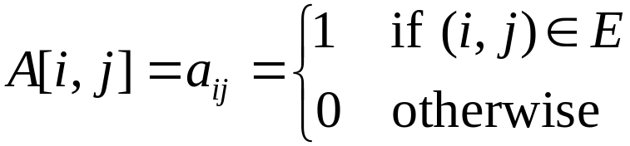
Adjacency Matrix
|V| × |V| matrix A.
Number vertices from 1 to |V| in some arbitrary manner.
A is then given by:
1
2
1 2 3 4
1 0 1 1 1
2 0 0 1 0
3 0 0 0 1
4 0 0 0 0
a
b
c
d
4
3
1
2
1 2 3 4
1 0 1 1 1
2 1 0 1 0
3 1 1 0 1
4 1 0 1 0
a
b
A = A^{T} for undirected graphs.
c
d
3
4
UCT203 Data Structures and Algorithms

Slide 10
Space and Time
Space: Θ(V²).
  Not memory efficient for large graphs.
Time: to list all vertices adjacent to u: Θ(V).
Time: to determine if (u, v) ∈ E: Θ(1).
Can store weights instead of bits for weighted graph.
UCT203 Data Structures and Algorithms

Slide 11
Graph-searching Algorithms
Searching a graph:
  Systematically follow the edges of a graph
  to visit the vertices of the graph.
Used to discover the structure of a graph.
Standard graph-searching algorithms.
  Breadth-first Search (BFS).
  Depth-first Search (DFS).
UCT203 Data Structures and Algorithms

